Slide 1
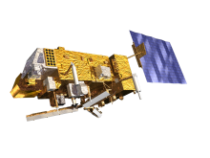

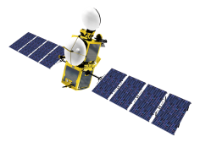
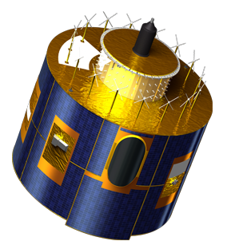


Future Satellite Services
Sentinel-3 Mission
H. Bonekamp
Visit of the Group for Earth Observation
2 July 2015

Slide 2
EUMETSAT and the Sentinels
EUMETSAT Direct EUMETSAT User Community
Programmatic Engagement : interest/link:
Sentinel-1 - Marine Meteorology, Sea Ice
Sentinel-2 - E.g. marine environment ,
Sentinel-3 Sentinel-3 Marine Mission Oceanography, Marine (Marine Centre) Meteorology, Sea Ice, Seasonal Forecasting, Climate,
Marine Environment
Sentinel-4 Part of EUMETSAT MTG System Atmospheric Composition (GEO)
Sentinel-5 Part of EUMETSAT EPS-SG systems Atmospheric Composition (LEO)
Sentinel-6 Jason Continuity of Service Oceanography, Climate
EUMETSAT Optional Program
with Partners (follow-on of Jason-2/3)

Slide 3
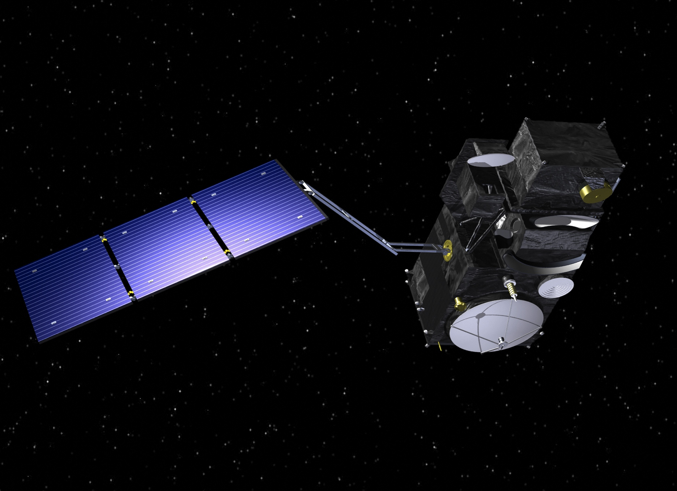
Sentinel-3 Satellite and Payload
Main satellite characteristics
1250 kg maximal mass
Volume in 3.89 m x 2.202 m x 2.207 m
Average power consumption of 1100 W
7.5 years lifetime (fuel for 5 add. years)
Large cold face for optical instruments
thermal control
Modular accommodation for a simplified
management of industrial interfaces
Microwave
Radiometer
Ocean and Land Colour Instrument
Sea and Land Surface Temperature Radiometer
X-band Antenna
GPS
DORIS Antenna
Laser retro-reflector
SAR Radar Altimeter
S-band Antenna

Slide 4
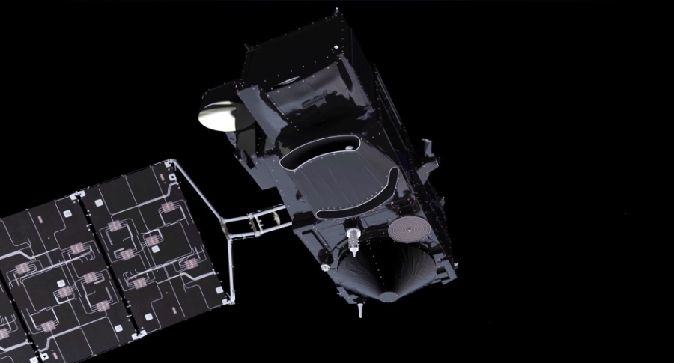
Continuity challenge: Sentinel-3 A and B, C and D
A : planned!
B : planned!
http://www.esa.int/Our_Activities/Observing_the_Earth/Copernicus/Sentinel-3;
C : proposed
D : proposed

Slide 5
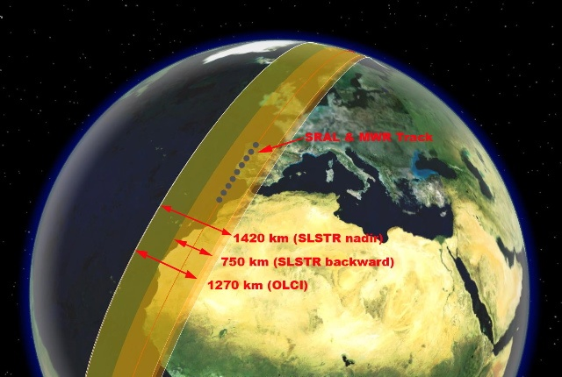
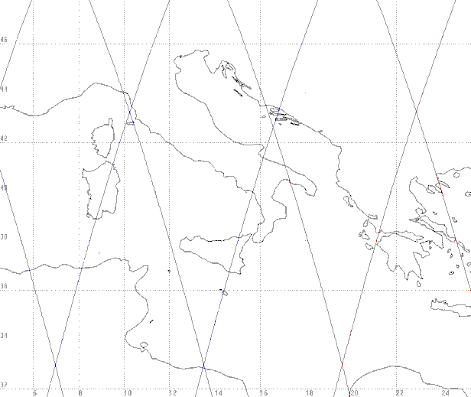
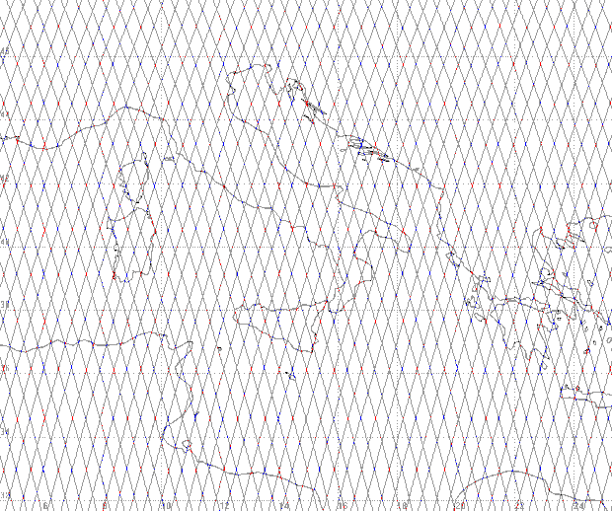
Orbit and Swaths
Instrument Swath Patterns
Ground Track Patterns
S3-A
S3-B
SRAL (>2 km) and MWR (20 km) nadir track
2 days
1400 km SLSTR (nadir)
740 km SLSTR (oblique)
1270 km OLCI
Orbit type
Repeat cycle
LTDN
Average altitude
Inclination
Repeating frozen SSO
27 days (14 + 7/27 orbits/day)
10:00
815 km
98.65 deg
1 Repeat Cycle (27 days)
We care for a safer world

Slide 6
Services and Requirements overview
Marine (EUMETSAT)
Land (ESA)
GMES Initial
Service GMES
Marine & Coastal
Environment
Polar
Environment
monitoring
Maritime
Security
Global
Change
Ocean
Sentinel–3
Requirement
sea-surface topography.
mesoscale circulation.
water quality.
sea-surface temperature.
wave height and wind.
sediment load and
Transport eutrophication.
sea-ice thickness ice.
surface temperature.
ocean-current forecasting
water transparency.
wind and wave height.
global sea-level rise.
global ocean warming.
ocean CO₂ flux.
GMES Initial
Service GMES
Global Change
Land
Land Cover &
Land Use Change
Forest
Monitoring
Flood
Security
Early Warning
Humanitarian
Aid
Air Pollution
(Local to
Regional Scales)
Risk
Management
(flood & Fires)
Sentinel–3
Requirement
forest cover
Change mapping.
soil degradation
Mapping.
land use mapping
Vegetation indices.
forest cover
mapping.
regional land-
Cover mapping.
drought monitoring.
land use mapping.
aerosol
concentration.
burned scar mapping.
fire detection.

Slide 7

Services: “Different users and applications means, …
Different services and products !”
  Different levels:
    level 1A, Level 1b
    Level 2
    (Level 3 and Level 4)
    (Level 0 is not served)
  Different ‘Flavours’:
    Level 1A, 1B, 1bS
    level 2, reduced, standard, enhanced
    Low/ High Resolution
    Different Content
  Different Timeliness
  Different dissemination mechanisms
  (Different agencies)

Slide 8
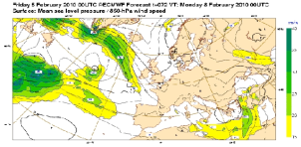
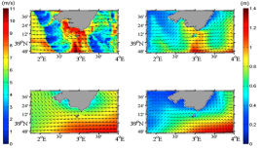
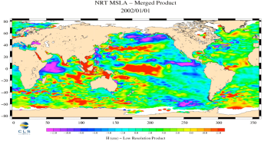
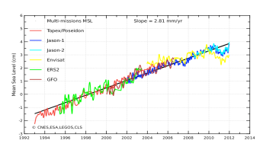
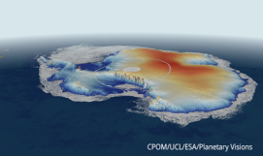
Services: 3 Timelinesses and reprocessing
3 h
2-3 d
~30 d
~every 1-2 y
time
Ocean forecasting,
Meteorology,
Oceanography
NRT products
Operational Ocean,
Ocean forecasting,
Oceanography
STC products
Climatology,
Oceanography,
Data exploitation
NTC products
Reprocessing Campaign
(only NTC products)
Altimetry products
NRT: Near Real time
STC: Slow Time Critical
NTC: Non time Critical

Slide 9
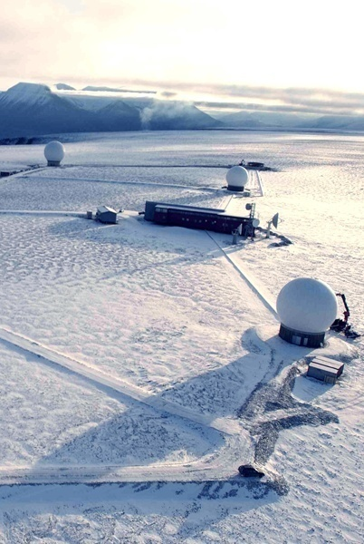








Sentinel-3 Ground Segment Overview
ESA Land Off-line Processing and Archiving Centres (PACs)
ESA Land Mission Performance
Centre (MPC)
ESA Core Ground Station (CGS) and
Land NRT Processing Centre
Ocean Colour
For Land Applications
Land Surface
Temperature
Land Altimetry
Performance of cal / val activities
Routine Quality Control
Help Desk Support
LEOP & Commissioning
Flight Operations Segment
Production of L1/L2 STC & NTC Land & Synergy Products
Long Term Archiving of L0 & L1 Products
Long Term Archiving of L2 Land & Synergy Products
Reprocessing of land products
Satellite M&C
EUMETSAT Marine Centre
X Band Dump Acquisition
Production of NRT L1
Production of L0 products
Production of NRT L2 land products
Mission Management
Office
Production of L0 products
Production of NRT L1
Production of NRT L2 marine products
Production of L1/L2 STC & NTC marine products
Dissemination of L1/L2 NRT & STC over EUMETCast
Long Term Archiving of L0 & L1 products
Long Term Archiving of L2 marine products
Reprocessing of marine products
Mission Management
ESA Data Circulation and Dissemination Network
Satellite M&C
Mission Planning
Mission Management
Routine Quality Control
Help Desk Support
Performance of cal / val activities

Slide 10
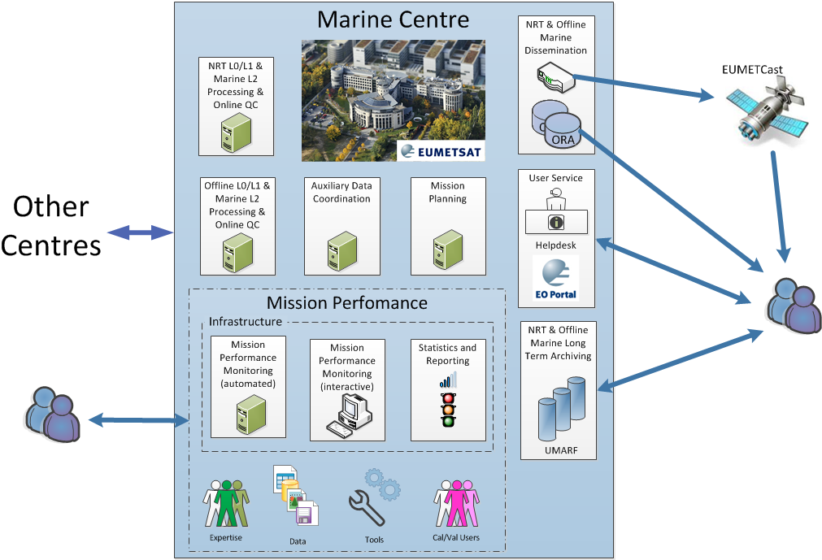
Sentinel-3 Marine PDGS Centre
EUMETSAT Multi-Mission Elements

Slide 11
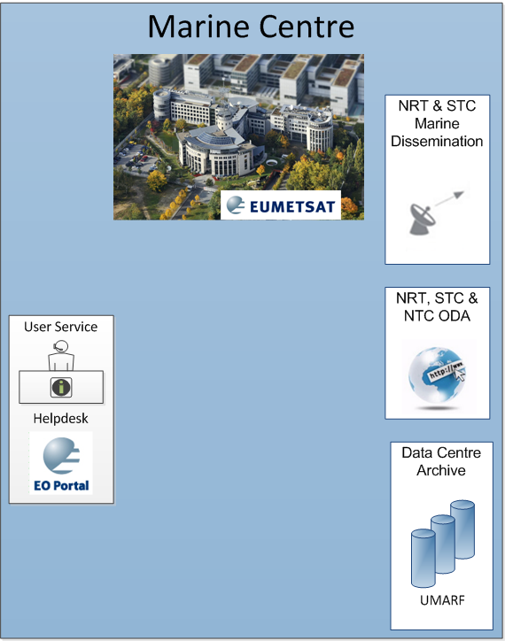
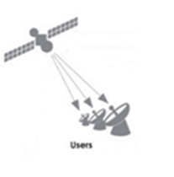

EUMETSAT Sentinel-3 Services and Data Access
EUMETCast
Traditional method of disseminating NRT data in EUMETSAT. Can involve satellite and terrestrial methods.
User Support
User Registration & Support, Product Discovery Helpdesk, etc
Online Data Access (ODA)
Rolling archive of 1 month of data supporting ftp/http access
EUMETSAT Data Centre
Complete historical archive of all EUMETSAT data including S-3 marine data

Slide 12




Sentinel-3 product format (SAFE)
XML
Manifest
Measurement
Data
Data
(e.g. img.,
param.)
Quicklook
PREVIEW
Map
PRODUCT
Preview
ANNOTATIONS
Annotations
Products metadata
XML
XML Schema
XML Schema files for measurement data and annotations
SUPPORT
XSD

Slide 13
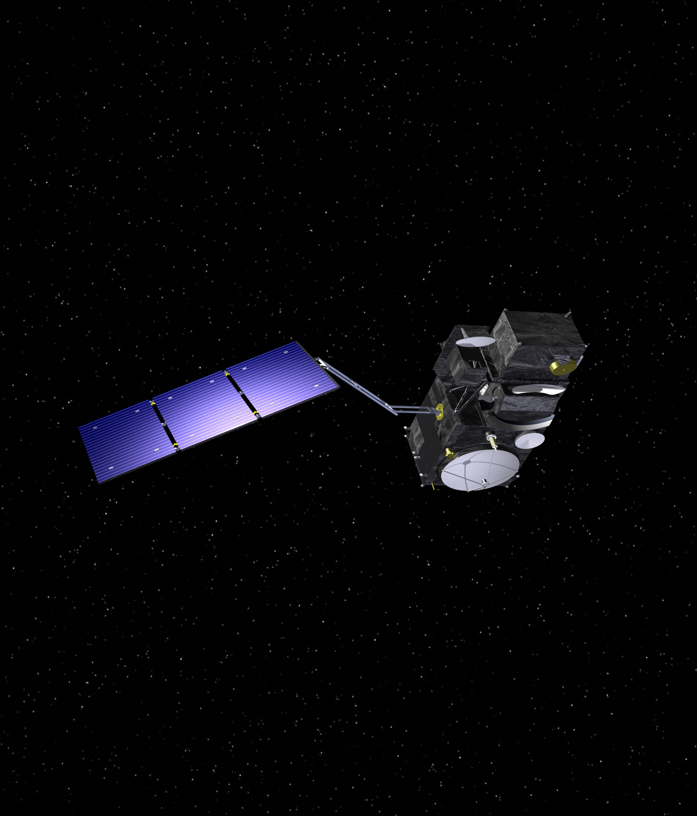
Sentinel-3 Altimetry Payload
SAR Radar Altimeter (SRAL)
Ku/C band
Measurement modes: SAR and LRM
Tracking modes: closed and open-loop
Total range error: 3 cm
Microwave Radiometer
GNSS
MicroWave Radiometer (MWR)
Dual frequency, 23.8 / 36.5 GHz
Radiometric accuracy, 3 K absolute (0.6 K relative)
Laser Retro- Reflector
DORIS Antenna
Precise Orbit Determination (POD) including:
GNSS receiver (Global Navigation Sat. System)
DORIS Doppler Orbitography and Radiopositioning Integrated by Satellite
LRR Laser Retro reflector
SAR Radar Altimeter

Slide 14
Sentinel-3 Altimetry Products
Level 1 products
SRAL & MWR L1 products
L1B, L1A, L1B-S
Generated by ESA/EUMETSAT
@ CGS, Marine Center, Land Centers
Level 2 Marine products
STM L2 Marine product “SR_2_WAT”
→ Generated by EUMETSAT at PDGS Marine
Center
Level 2 Land products
STM L2 Land product “SR_2_LAN”
→ Generated by ESA at PDGS Land Centers
Measurements included in the MARINE product
Measurements included in the LAND product
Land and Water masks are in overlap to ensure analysis of transition and meaningful continuity of segments
300Km over ocean – 10 km over land
Marine product: information sensed over open ocean,
coastal areas, sea-ice + mask margin
Land product: information sensed over land, coastal areas,
sea-ice, land ice and inland water + mask margin

Slide 15
S3 Altimetry L2 products. 3 flavours per timeliness
PLRM Ku/C band measurement
“Reduced”
Measurement Data File
→ 1Hz information
PLRM Ku/C band measurement
“Standard”
Measurement Data File
→ 1Hz + 20 Hz information
NRT STC NTC
L1A X X
L1B-S X X
L1B X X
L2 SR_2_WAT X X X
L2 SR_2_LAN X X X
PLRM waveforms
“Enhanced”
Measurement Data File
1Hz + 20 Hz + WF information

Slide 16
Baseline Sea Surface Height, Sea Ice Products (SRAL)
Product Class (ID) | Parameter | Parameter Description
Level 1b (SRAL-L1B) | Radar echoes, single waveform σ₀ values in LRM Mode Radar echoes, single bursts σ₀ values in SAR Mode | 20Hz data in Ku- and C-band, instrument and geophys. corrections applied Note: Calibration Measurements (SR_1_CAL) are produced as a separate product
Level 2 Marine Ocean and Sea Ice Areas (SRAL-L2MA) | Elevation values (R) Backscatter coefficient Sea Surface Height anomaly (SSHA) Signification Wave Height (SWH) Wind speed (WS) LRM Mode only | all parameters except backscatter coeff and Wind Speed are provided for LRM and SAR mode in one product
 | sea ice freeboard | height of sea ice floes above sea surface
 | sea ice sea surface height | Height of the sea surface in sea-ice areas with respect to a reference datum
 | sea ice surface height anomaly | Variations of the Sea Ice Surface Height with respect to a mean sea surface (m)
  To be operated in 100% high resolution SAR mode globally and provision of L1 products to users (later)

Slide 17
Sentinel-3 Optical Payload
(Microwave
Radiometer)
Ocean and Land Colour Instrument
(OLCI)
Sea and Land Surface Temperature Radiometer
(SLSTR)

Slide 18

Optical Products :
OLCI
OLCI
&
SLSTR
SLSTR
PRODUCTS
SYNERGY PRODUCTS
PRODUCTS
L
2
FR
L
2
FR
L
2
RR
L
2
RR
L
2
L
2
L
2
L
2
L
2
Land
L
2
Water
L
2
Land
L
2
Land
Water
Land
Water
SYN
VGT
_
P
VGT
_
S
1
VGT
_
S
10
OL
_
2
_
WFR
OL
_
2
_
LRR
SR
_
2
OL
_
_
2
_
LFR
OL
_
2
_
WRR
SY
_
2
_
SYN
SY
_
2
_
VGP
SY
_
2
_
VG
1
SL
_
2
_
LST
SL
_
2
_
SY
WST
_
2
_
V
10
SR
_
2
_
LAN
VEGETATION
-
LIKE PRODUCTS
L
1
FR
L
1
RR
L
1
OL
_
1
_
EFR
SL
_
1
_
OL
RBT
_
1
_
ERR
L
2
Marine
L
2
Land
L
1
Products
Products
products
Produced by EUMETSAT
Produced by ESA
Produced by both ESA and EUMETSAT

Slide 19
Baseline Sea Surface Temperature Products (SLSTR)
Product Class (ID) | Parameter | Parameter Definition
SLSTR Level 1B (SLSTR-L1B) | Top of Atmosphere radiances Top of Atmosphere brightness temperatures | Radiance in [W m s2 sr-1 µm-1] of band S1-S3. Brightness Temperatures for S4-S9 in [K]. All values in dual view with time stamps, flags, geo-location and meteo annotation data set
SLSTR Level 2 SST (SLSTR-SST) | Sea Surface skin Temperature (SST) | Stand-alone product conforming to the GHRSST L2P specification, containing a composite ”best SST” field, error estimates and contextual auxiliary data fields, SST in [K] and various other units. Note: intermediate SST estimates (D2/D3/N2/N3 SSTskin products) are produced but not distributed

Slide 20
Baseline Ocean Colour Products (OLCI)
Product Class (ID) | Parameter | Parameter Definition
OLCI Level 1 in RR and FR (OLCI-L1B) | Top of Atmosphere radiances | Radiance in [W m s2 sr-1 µm-1] of 21 OLCI bands with time stamps, flags, geo-location, meteo annotation data set
OLCI Level 2 in RR and FR (OLCI-L2WLR) | Water leaving reflectance (R) | Surface directional reflectance, dimensionless, corrected for atmosphere and Sun specular reflection, at all OLCI channels except those dedicated to atmosphere absorption measurements, and associated error estimates.
Ocean Colour Products (OLCI-L2OC) [ | Algal pigment concentration 1 (Chl-1) | Chlorophyll-a concentration in Case 1 waters and associated error estimates, in mg.m-3
 | Algal pigment concentration 2 (Chl-2) | Chlorophyll-a concentration in Case 2 waters and associated error estimates, in mg.m-3
 | Total Suspended Matter concentration (TSM) | Total suspended matter concentration, and associated error estimates, in g.m-3
 | Diffuse Attenuation coefficient (Kd) | Diffuse attenuation coefficient for downwelling irradiance, and associated error estimates, in m-1 at 490 nm.
 | CDM absorption coefficient (CDOM) | Absorption of Coloured Detrital and Dissolved Material, and associated error estimates, expressed in m-1 at 443 nm.

Slide 21
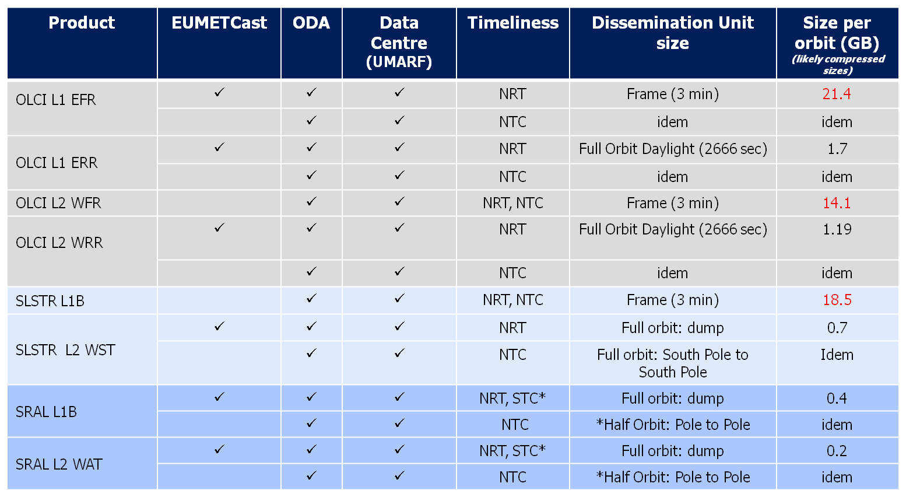
Marine PDGS Dissemination baseline

Slide 22

Sentinel-3 Services. Some take home messages
Wonderful Services for Marine (EUMETSAT) and Land (ESA) Applications
Long term services: 4 satellites: 2 approved; 2 planned.
The S-3 Marine Centre at EUMETSAT is the core S-3 service for the operational marine applications.
Complex product, service and dissemination structure.
User Product Format: all measurement data in NetCDF, Safe encapsulations
Launch Sentinel-3 A; End October 2015

